Slide 1
How the Great Depression Affected Children
A Photographic Exercise
Directions: Answer the questions on the handout to go along with each photograph.

Slide 2
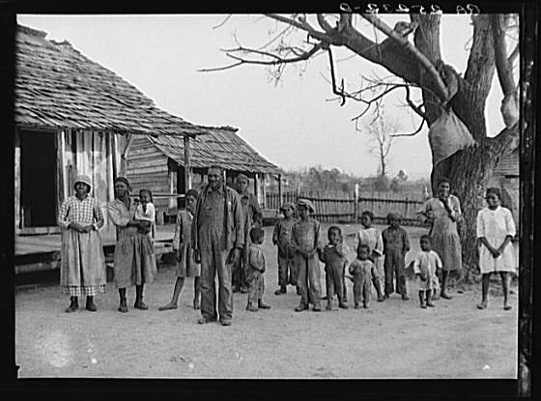
http://historymatters.gmu.edu/mse/photos/question2.html#!
Notes:
This picture was taken by Arthur Rothstein in 1937 in Gee’s Bend, Alabama. The people are descendants of former slaves of the Pettway Plantation.

Slide 3
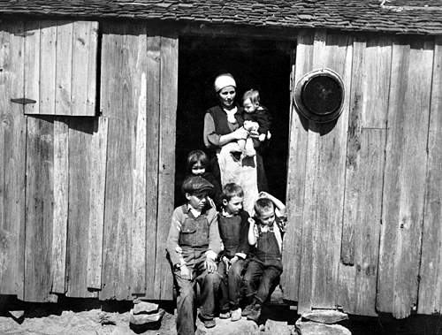
This picture was taken in Walker County, Alabama, by the Farm Security Administration.
http://newdeal.feri.org/library/s17.htm

Slide 4
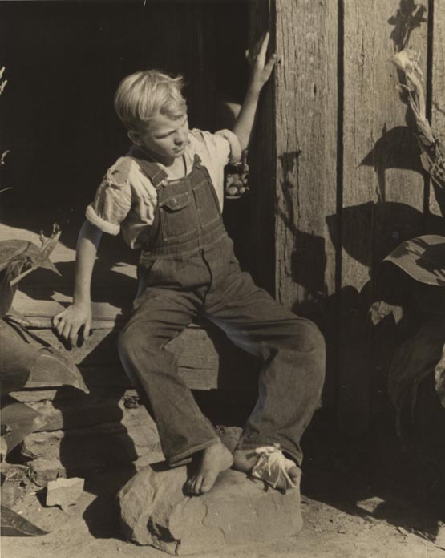
http://digital.archives.alabama.gov/u?/photo,467

Slide 5
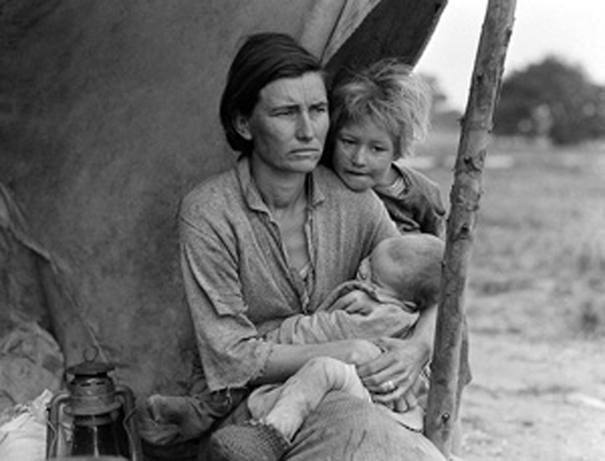
Who do you see in the picture?
Where does this picture take place?
What is going on in this picture?
Does this look like where you live today?
How would you describe the children in the picture?
What kind of lifestyle do you think the family might have?
What clues make you think this?
http://www.picture-america.com/LuceB/Migrant-Mother-Project/great-depression-family.htm
Notes:
This is a photograph of Florence Owens, better known as the Migrant Mother. This is one of the six famous photographs taken by Dorothea Lange. It was taken just outside a pea pickers camp in California during the Great Depression.

Slide 6
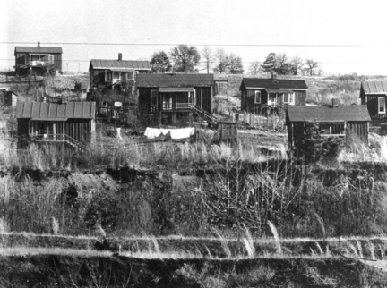
http://blog.al.com/mhuebner/2009/10/digging.html
Notes:
This picture was taken by Walker Evans in 1935. The picture depicts homes of miners near Birmingham, Alabama. These homes were two-room houses with no indoor plumbing, no electricity, and no adjacent streets,

